Slide 1
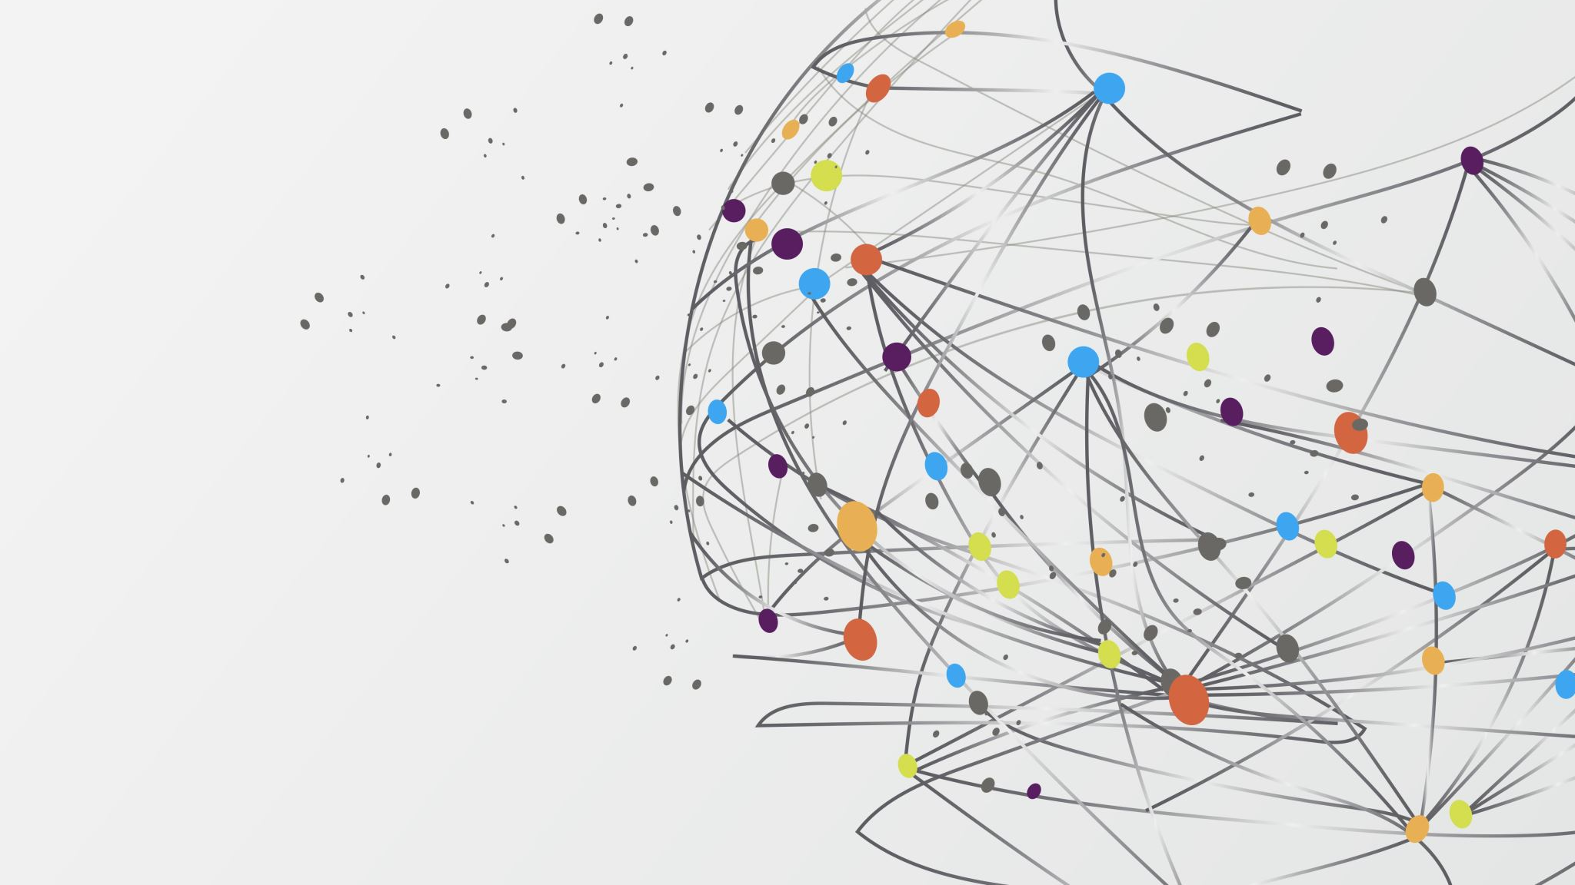
Load Balancer
Deliver high availability and network performance to your apps

Slide 2
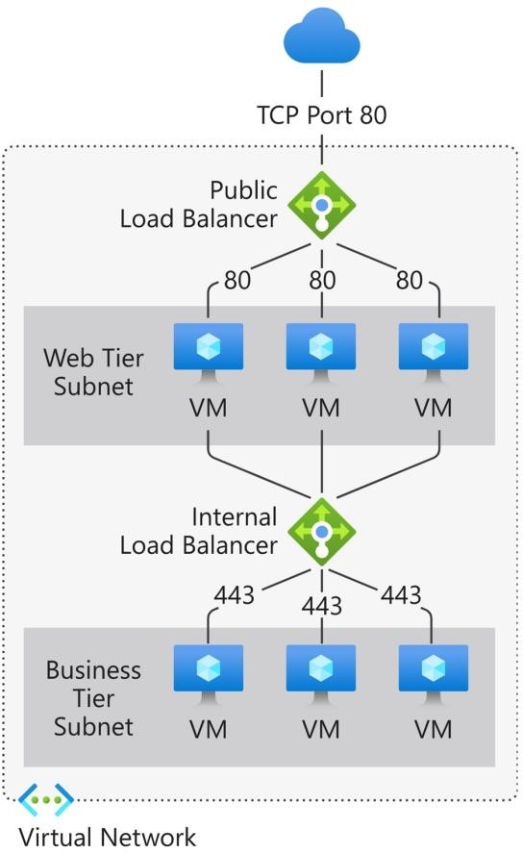
Load Balancer
Distribute traffic to your backend virtual machines
Provides high availability for your application.
Two types of load balancer: Public and Private
Components:
Frontend IP: define IP address for the load balancer
Backend pool: this contains the virtual machines
Health probes: monitor health of resources in backend pool
Rules: How to distribute the incoming traffic.

Slide 3
Availability Zones
High availability for your mission-critical applications and data

Slide 4

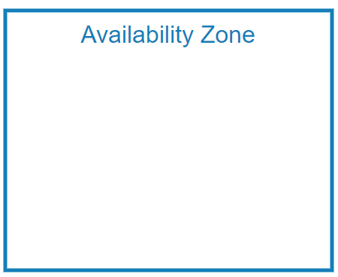




Availability Zones
▪
Each Availability Zone has a distinct power source, network, and cooling.
▪
If one zone is compromised, then replicated apps and data are instantly available in another zone.
▪
It’s your responsibility to sync applications
between different VMs.
High-speed, private
fiber-optic networks

Slide 5
Availability sets
Provides High availability and Business continuity for applications

Slide 6
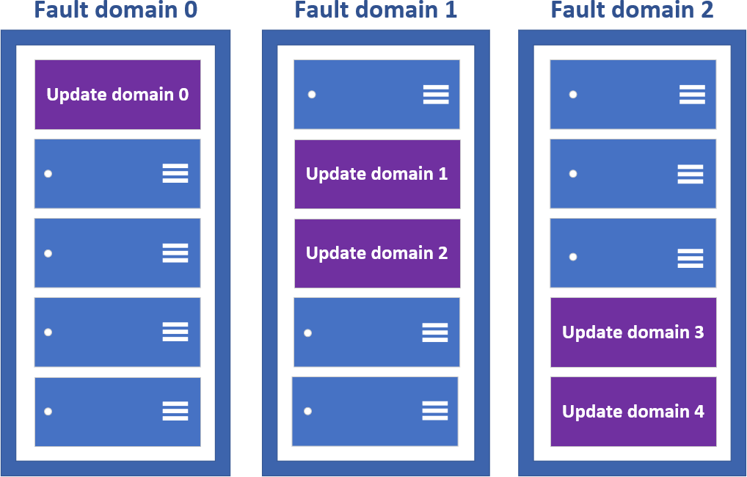
Availability Sets
▪
Availability Sets make use of two key concepts - Fault Domains, and Update Domains.
▪
Update domains define the group of virtual machines that are going to be
patched/maintained/rebooted at same time.
▪
Fault domains define the group of virtual machines that share a common power source and network switch.
▪
It saves from rackwide failure, or a rackwide maintenance window that can take down all VMs hosted on this single point of failure.
▪
Availability sets are free to use! You only pay for the virtual machines being created.
▪
It does not protect your application from operating system or application- specific failures, it does limit the impact of potential physical hardware failures, network outages, or power interruptions.

Slide 7

Virtual Machines Scale Sets
Manage and scale up to thousands of Linux and Windows VMs

Slide 8
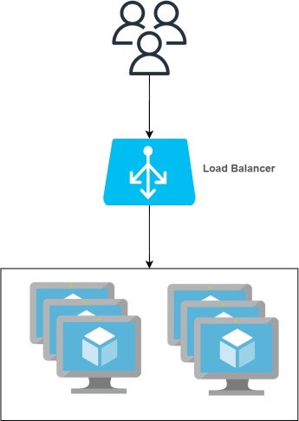
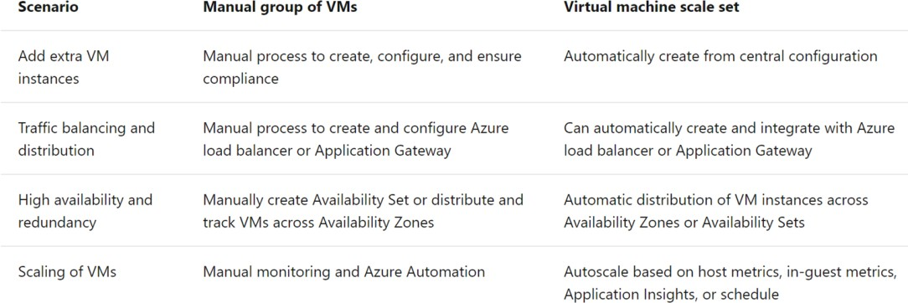
Virtual Machines Scale Sets
▪
Create and manage a group of load balanced VMs.
▪
Allows your application to automatically scale as resource demand changes
▪
The number of VM instances can automatically increase or decrease in response to demand or a defined schedule.
▪
All VM instances are created from the same base OS image and configuration.
▪
VM size, disk configuration, and application installs should match across all VMs.
▪
Provides high availability and application resiliency
Can use availability zones or availability sets
There is no cost for the scale set itself, you only pay for each VM instance that you create.
▪
https://docs.microsoft.com/en-us/azure/virtual-machine-scale-sets/overview

Slide 9
Azure App Service
Enables you to build and host web apps, background jobs, mobile back-ends, and RESTful APIs

Slide 10

Azure App Service
Enables you to host and manage your web applications
Platform as a service (PaaS) environment
Focus on the business value and logic
Azure handles the infrastructure
Automatic scaling and high availability
Programming language of your choice
Supports Windows and Linux
Automated deployments from GitHub or Azure DevOps
Pay only for compute resources your app uses
App Service plan determines how much hardware is devoted to
your application

Slide 11
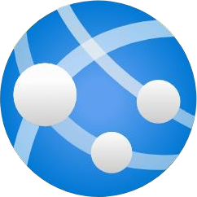
Types of app services
Web apps
Full support for hosting websites and web applications
Language: ASP.NET, ASP.NET Core, Java, Ruby, Node.js, PHP, or Python.
Operating System: Windows or Linux
Web apps for containers can host your existing container images.
API apps
Build REST-based web APIs
Choice of language and framework
Can be consumed from any HTTP- or HTTPS-based client.
WebJobs
Run a program (.exe, Java, PHP, Python, or Node.js)
Run a script (.cmd, .bat, PowerShell, or Bash)
Can be scheduled or run by a trigger
Often used to run background tasks as part of your application logic.
Mobile apps
Quickly build a back end for iOS and Android apps
Store mobile app data in a cloud-based SQL database.
Authenticate customers against common social providers, such as MSA, Google, Twitter, and Facebook.
Send push notifications.
Execute custom back-end logic in C# or Node.js.

Slide 12
Containers
Wrap up an application into its own isolated package

Slide 13
Containers
Problem Statement 1: I can’t share project with others because of dependencies on OS, framework, libraries and so on.
Problem Statement 2: Need different machines to run three different Python-based applications that use of a different version of Python
Solution: The simple solution is to create a container of your project in which you mention all the dependencies to run the project.
Thus your project can be run universally on any computer having container runtime installed.
Containers are a way to wrap up an application into its own isolated package.
In a nut shell, Container is the modern era solution for transferring your projects to friends, family, colleagues, clients etc without worrying about their system configuration to run the project.
Imp Features:
Portability: Deploy to diff environment
Consistency: will behave same each time
No maintenance related to infrastructure
Deployment and maintenance are efficient
Auto scaling
Apps
DLLs/ Libs
Container

Slide 14
ACI vs AKS
Azure Container Instances (ACI) vs Azure Kubernetes Services

Slide 15
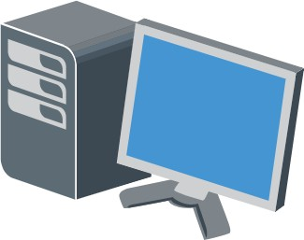

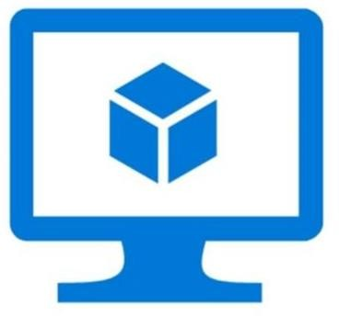
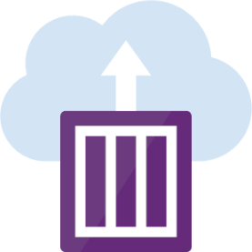
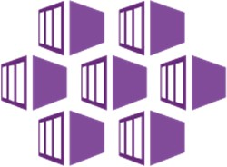

Hosting Options for Containers
Local Workstation
On-premises Servers
VMs in Azure
Azure Container Instances (ACI)
Azure Kubernetes Services (AKS)
Azure App Services

Slide 16
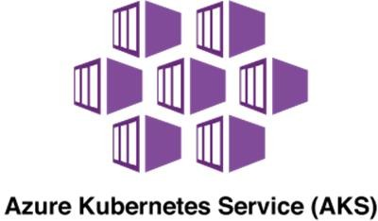
ACI vs AKS
ACI is a service that lets you deploy containers on Azure without having to
maintain or patch the environment.
Basic web applications, DevTest scenarios, and batch processing are all supported by ACI.
When you just need to run a few containers, it's a perfect option.
Limited scalability and low availability
Managed environment
Only pay for containers
Deployment is easy.
Azure Container Instances (ACI)
Alternatively, For more complex container designs where you require additional control over the health and performance of your containers, you may utilize Azure Kubernetes Service (AKS).
You can coordinate the deployment, update, and management operations for all of your containers using AKS.
If you need to operate tens, hundreds, or even thousands of containers, the AKS Open source project could be a good fit.
It's one tool in a class of tools called container orchestrators

Slide 17
Azure Kubernetes Services (AKS)
Azure's container management system
Scale your application to meet demands by adding and removing
container instances
Monitor the deployed containers and resolving any issues that
may come
Groups of containers are called Pods
Virtual machines are called Nodes
Azure Container Registry pull

